Slide 1
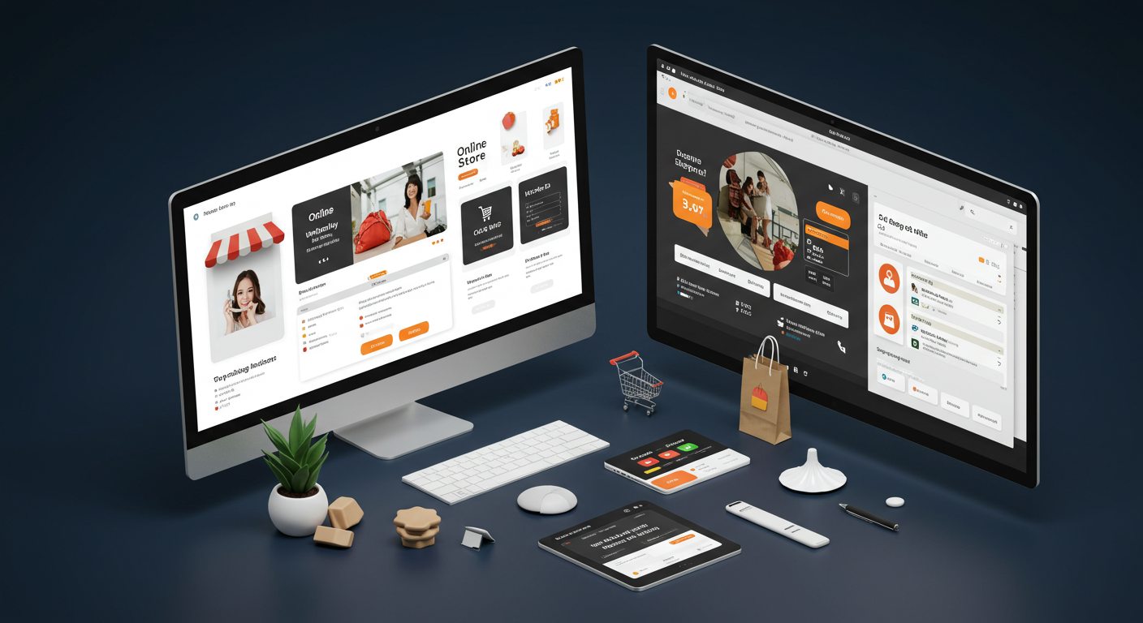
SuperShop – ML Analysis
CSCN8030 – Artificial Intelligence for Business Decisions and Transformation

Slide 2
Introduction
The SuperShop dataset provides a rich set of retail transaction data, including sales, customer information, product details, and profitability metrics.
This presentation explores the dataset to extract meaningful insights and propose three impactful machine learning use cases: sales forecasting, profitability prediction, and customer segmentation.
These use cases aim to optimize inventory management, enhance profitability, and enable personalized marketing strategies.

Slide 3
Dataset Overview
Source: Kaggle (Supershop_dataset)
Description: Contains sales transaction data for an online store.
Rows: 9,995
Columns: 21
Key Features:
Order Details: Order ID, Order Date, Ship Date, Ship Mode
Customer Details: Customer ID, Customer Name, Segment
Product Details: Product ID, Category, Sub-Category, Product Name
Transaction Details: Sales, Quantity, Discount, Profit

Slide 4
Problem Statement
Businesses face challenges in effectively managing inventory, maximizing profitability, and delivering personalized customer experiences.
Without accurate sales forecasting, profitability insights, and customer segmentation, decision-making becomes reactive and inefficient.
This presentation addresses these challenges by leveraging the SuperShop dataset to propose machine learning solutions that optimize inventory planning, enhance profit margins, and improve customer engagement through data-driven strategies.

Slide 5
Sales Forecasting
Businesses often struggle with predicting future sales, leading to overstocking or stockouts. This impacts inventory management, increases operational costs, and reduces customer satisfaction. A robust sales forecasting model is needed to predict demand accurately and ensure optimal stock levels.
Objective: Predict future sales for better planning.
Impact:
Helps optimize stock levels.
Improves revenue prediction accuracy.

Slide 6
Profitability Prediction
Identifying unprofitable transactions and products is a challenge for businesses, especially when discounts and promotions heavily influence profits. Without accurate insights into profitability, businesses risk losing revenue and fail to optimize pricing strategies. A machine learning model can help predict profitability and guide decision-making to maximize margins.
Objective: Predict profitability of orders to identify unprofitable products or regions.
Impact:
Guides discount strategies.
Highlights loss-making products or regions.

Slide 7
Customer Segmentation
Delivering personalized customer experiences is essential for customer retention and satisfaction. However, businesses often lack a clear understanding of customer behavior and preferences. This results in generic marketing strategies with limited impact. Machine learning-based customer segmentation can group customers by their purchasing patterns, enabling targeted marketing and improved customer engagement.
Objective: Group customers based on purchasing behavior for targeted marketing.
Impact:
Personalizes customer engagement.
Boosts sales through tailored offers.

Slide 8
Sales Forecasting

Slide 9
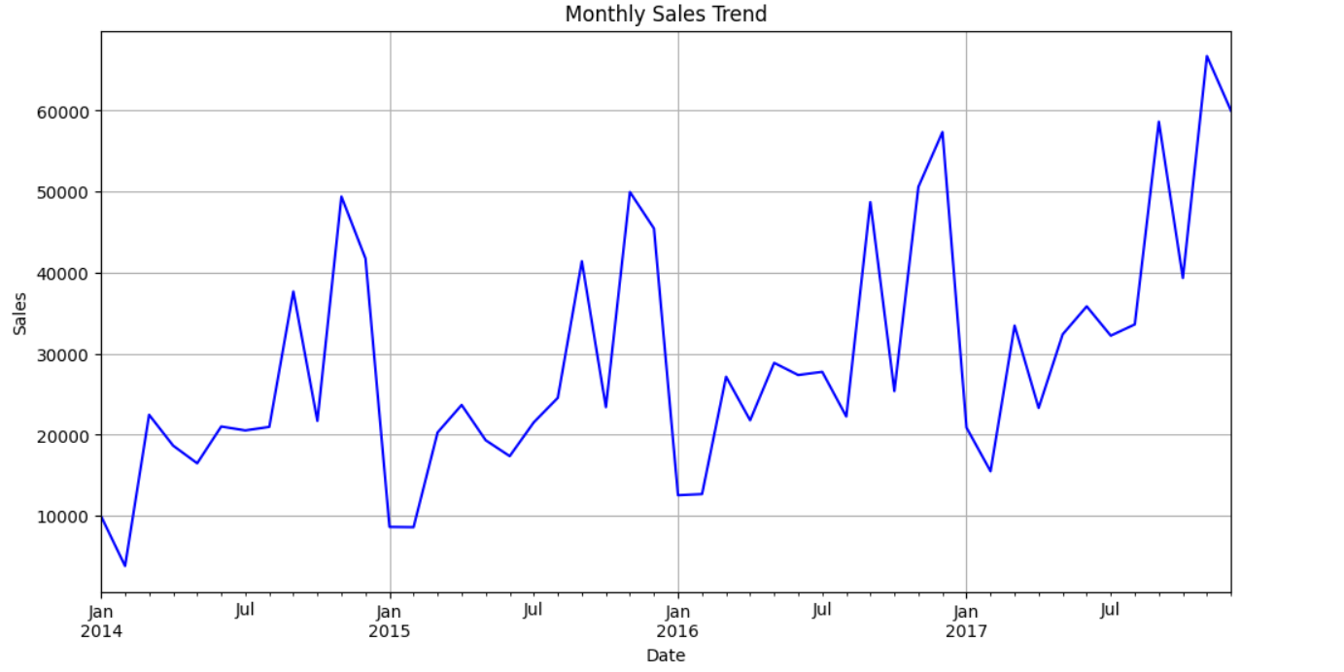
Sales Trend Over Time
The graph shows a clear upward trend in sales over the period from 2015 to 2017. This indicates that the business has been growing steadily during this timeframe.
There appears to be some seasonality in the sales data as well. We can observe peaks and troughs that seem to repeat annually.

Slide 10
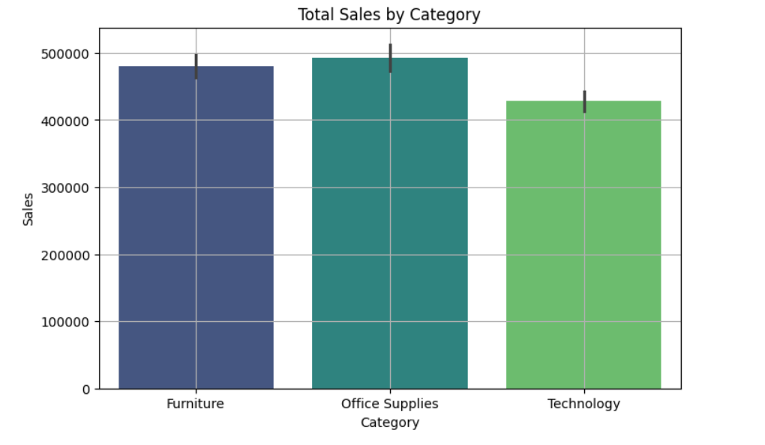
Sales by Category
The sales are pretty evenly spread out across the three categories with Technology sales leading marginally.

Slide 11
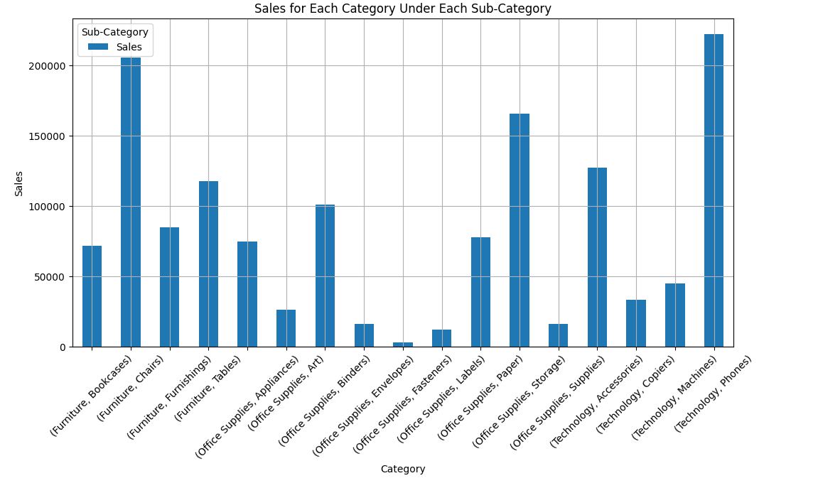
Sales For Each Category Under Sub-Category
The graph shows that phones and chairs are the most sold items.

Slide 12
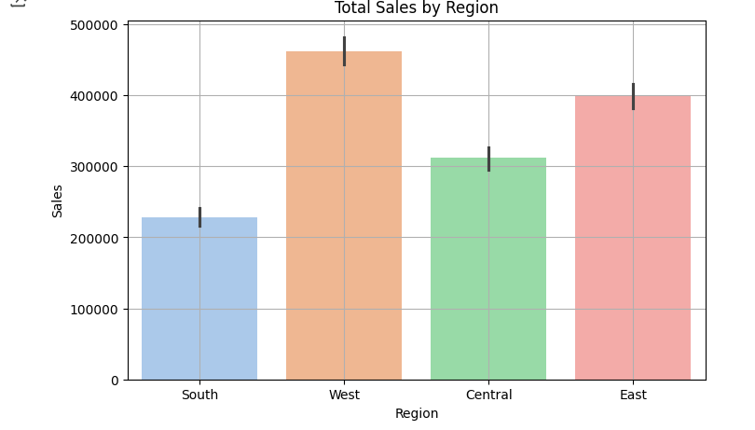
Total Sales By Region
Highest Sales: The West region has the highest sales, exceeding 700,000.
- Lowest Sales: The South region has the lowest sales, around 400,000.

Slide 13
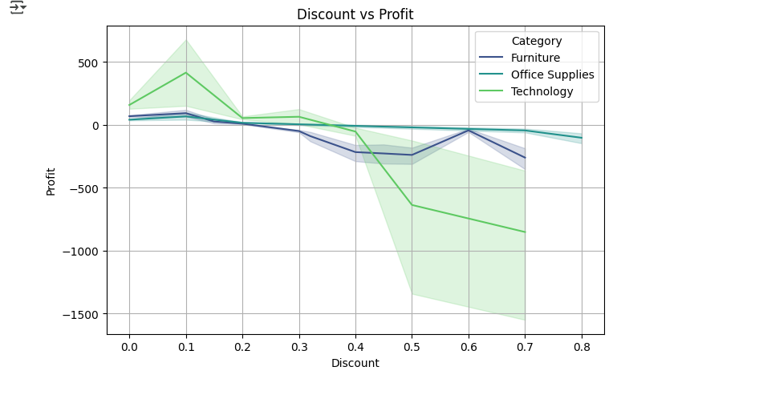
Impact Of Discount On Profit
The graph shows a general downward trend in profit as the discount rate increases for all three product categories: Furniture, Office Supplies, and Technology. This suggests that offering higher discounts leads to lower overall profits.

Slide 14
ML Model
Used time-series Forecasting Model to predict future sales:
ARIMA (Autoregressive Integrated Moving Average)
LSTM (Long Short Term Memory)

Slide 15
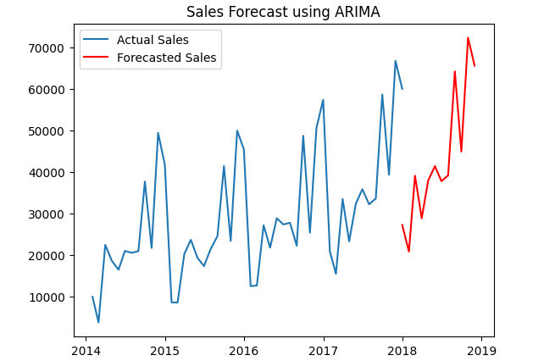
ARIMA

Slide 16
ARIMA
Metrics
RMSE – 5624.43
MAE – 5619.49
R² Score – 0.87
An R² of 0.87 suggests that your model captures the underlying patterns and trends effectively, though 13% of the variance remains unexplained.

Slide 17
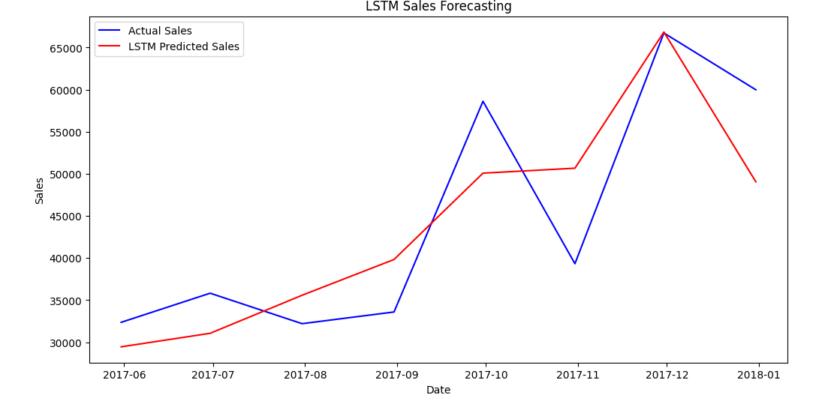
LSTM

Slide 18
LSTM
Metrics
RMSE – 8902.49
MAE – 7883.60
R² Score – 0.56
LSTM gave us an R2 score of 0.56 which indicates that the model explains 56% variance in data.

Slide 19
Conclusion & Future Scope
Out of the two models, ARIMA proved to be better model with 87% accurate prediction.
Model can be further improvised to predict sales of individual items based on category and sub-category to optimize the inventory.
Profitability prediction to come up with better discounting strategies.

Slide 20
Thank You

